Slide 1
Introduction To Databases

Slide 2
Basic Programming Experience

Slide 3
WHAT ARE Databases?
Necessity is the mother of invention

Slide 4
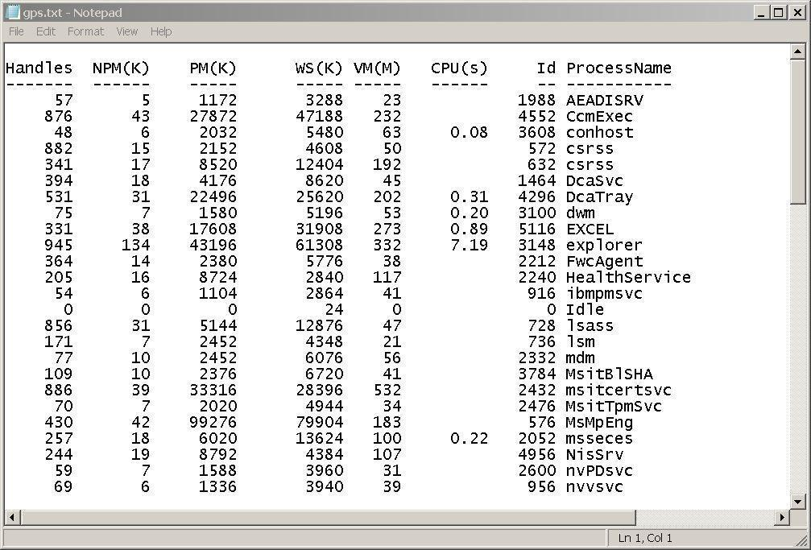

Slide 5
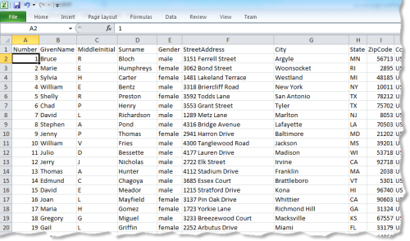

Slide 6
WHAT IS A DATABASE?
A database is an organized collection of data.
Database handlers create database in such a way that only one set of software program provide access of data to all the users.
The main purpose of database is to operate large amount of information by storing, retrieving and managing.
There are many dynamic websites on the world wide web now a days which are handled through databases. For example, a model to checks the availability of rooms in a hotel. It is an example of dynamic website that uses database.
There are many database available like MySQL, Sybase, Oracle, Mango DB, Informix, Postgre, SQL Server etc.
SQL or Structured Query Language is used to perform operation on the data stored in a database.

Slide 7
WHAT IS A DATABASE?
A database is a bunch of information
It is a structured collection of information
It contains basic objects, called records or entries
The records contain fields, which contain defined types of data, somehow related to that record.
A university database would contain for example all kinds of students as records, and students properties (ID,name, etc) as fields.

Slide 8
WHAT IS A DATABASE?
A database is searchable
It contains an index (table of content, catalog)
It is updated regularly
New data goes in
Obsolete, old data goes out
It is cross referenced To other databases

Slide 9
WHY DATABASES?
The main purpose of databases is not only to collect and organize data, but to allow advanced data retrieval and analysis
A database query is a method to retrieve information from the database
The organization of records into fields allows us to use queries on fields.

Slide 10
size
ease of updating
accuracy
security
redundancy

Slide 11
Database Management Systems (DBMS)
Oracle
SQL Server
MySQL
PostgreSQL
MongoDB
…

Slide 12
Relational DBMS
Hierarchical DBMS
Oracle
SQL Server
MySQL
PostgreSQL
MongoDB
…
Network DBMS
Object Oriented DBMS
NoSQL DBMS

Slide 13
What is RDBMS?
RDBMS stands for Relational Database Management Systems..
All modern database management systems like SQL, MS SQL Server, IBM DB2, ORACLE, My-SQL and Microsoft Access are based on RDBMS.
It is called Relational Data Base Management System (RDBMS) because it is based on relational model introduced by E.F. Codd.
Data is represented in terms of tuples (rows) in RDBMS.
Relational database is most commonly used database. It contains number of tables and each table has its own primary key.
Due to a collection of organized set of tables, data can be accessed easily in RDBMS.
Brief History of RDBMS During 1970 to 1972, E.F. Codd published a paper to propose the use of relational database model. RDBMS is originally based on that E.F. Codd's relational model invention.

Slide 14
Difference between DBMS and RDBMS
Although DBMS and RDBMS both are used to store information in physical database but there are some remarkable differences between them.
The main differences between DBMS and RDBMS are given below.
No. | DBMS | RDBMS
1) | DBMS applications store data as file. | RDBMS applications store data in a tabular form.
2) | In DBMS, data is generally stored in either a hierarchical form or a navigational form. | In RDBMS, the tables have an identifier called primary key and the data values are stored in the form of tables.
3) | Normalization is not present in DBMS. | Normalization is present in RDBMS.
4) | DBMS does not apply any security with regards to data manipulation. | RDBMS defines the integrity constraint for the purpose of ACID (Atomocity, Consistency, Isolation and Durability) property.
5) | DBMS uses file system to store data, so there will be no relation between the tables. | in RDBMS, data values are stored in the form of tables, so a relationship between these data values will be stored in the form of a table as well.
6) | DBMS has to provide some uniform methods to access the stored information. | RDBMS system supports a tabular structure of the data and a relationship between them to access the stored information.
7) | DBMS does not support distributed database. | RDBMS supports distributed database.
8) | DBMS is meant to be for small organization and deal with small data. it supports single user. | RDBMS is designed to handle large amount of data. it supports multiple users.
9) | Examples of DBMS are file systems, xml etc. | Example of RDBMS are mysql, postgre, sql server, oracle etc.

Slide 15
Relational Database Features

Slide 16
RDBMS?
Data Integrity
There are the following categories of data integrity exist with each RDBMS:
Entity integrity: It specifies that there should be no duplicate rows in a table.
Domain integrity: It enforces valid entries for a given column by restricting the type, the format, or the range of values.
Referential integrity: It specifies that rows cannot be deleted, which are used by other records.
User-defined integrity: It enforces some specific business rules that are defined by users. These rules are different from entity, domain or referential integrity.

Slide 17
columns
rows
table

Slide 19
columns
rows
table

Slide 20
columns
FirstName | LastName | HireDate | Grade | Salary | City
rows
table

Slide 21
columns
FirstName (text) | LastName (text) | HireDate (Date) | Grade (numeric) | Salary (currency) | City (text)
rows
table

Slide 22
columns
FirstName (text) | LastName (text) | HireDate (Date) | Grade (numeric) | Salary (currency) | City (text)
James | Black | 03/10/2014 | 7 | 15000 | HYD
rows
table

Slide 23
columns
FirstName (text) | LastName (text) | HireDate (Date) | Grade (numeric) | Salary (currency) | City (text)
FirstName | LastName | 03/10/2013 | 8 | 15000 | CA
James | Black | 03/10/2014 | 7 | 15000 | HYD
FirstName | LastName | 03/10/2013 | 8 | 15000 | CA
FirstName | LastName | 03/10/2013 | 8 | 15000 | CA
FirstName | LastName | 03/10/2013 | 8 | 15000 | CA
rows
table

Slide 24



DATABASES ON THE INTERNET
WEBSERVERS
DATABASE SERVER
USER

Slide 25

Introduction to MySQL

Slide 26
ROAD MAP
Introduction to MySQL
Connecting and Disconnecting
Entering Basic Queries
Creating and Using a Database

Slide 27
MySQL
MySQL (officially pronounced as "My S-Q-L") is an open-source relational database management system (RDBMS). Its name is a combination of "My", the name of co-founder Michael Widenius's daughter, and "SQL", the abbreviation for Structured Query Language. The MySQL development project has made its source code available under the terms of the GNU General Public License. MySQL was owned and sponsored by a single for-profit firm, the Swedish company MySQL AB, now owned by Oracle Corporation.
MySQL is written in C and C++. Its SQL parser is written in yacc, but it uses a home-brewed lexical analyzer. MySQL works on many system platforms.
The MySQL server software itself and the client libraries use dual-licensing distribution. They are offered under GPL version 2, beginning from 28 June 2000 (which in 2009 has been extended with a FLOSS License Exception) or to use a proprietary license.

Slide 28
MySQL
Support can be obtained from the official manual. Free support additionally is available in different IRC channels and forums. Oracle offers paid support via its MySQL Enterprise products. They differ in the scope of services and in price. Additionally, a number of third party organizations exist to provide support and services, including MariaDB and Percona.
MySQL was created by a Swedish company, MySQL AB, founded by David Axmark, Allan Larsson and Michael "Monty" Widenius. Original development of MySQL by Widenius and Axmark began in 1994. The first version of MySQL appeared on 23 May 1995. It was initially created for personal usage from mSQL based on the low-level language ISAM, which the creators considered too slow and inflexible. They created a new SQL interface, while keeping the same API as mSQL. By keeping the API consistent with the mSQL system, many developers were able to use MySQL instead of the (proprietarily licensed) mSQL antecedent.

Slide 29
MySQL
MySQL is a very popular, open source database.
Officially pronounced “my Ess Que Ell” people may called it (my sequel).
Handles very large databases; very fast performance.
Why are we using MySQL?
Free (much cheaper than Oracle!)
Each student can install MySQL locally.
Easy to use Shell for creating tables, querying tables, etc.
Easy to use with PHP

Slide 30
CONNECTING TO MYSQL
MySQL provides an interactive shell for creating tables, inserting data, etc.
On Windows open command prompt, and type/go to c:\xammp\mysql\bin, and type:
Mysql –u root -p
Or, click on the Shell icon on xampp controller.

Slide 31
SAMPLE SESSION
For example:
Enter password:
Welcome to the MariaDB monitor. Commands end with ; or \g.
Your MariaDB connection id is 4
Server version: 10.1.28-MariaDB mariadb.org binary distribution
Copyright (c) 2000, 2017, Oracle, MariaDB Corporation Ab and others.
Type 'help;' or '\h' for help. Type '\c' to clear the current input statement.
MariaDB [(none)]>
To exit the MySQL Shell, just type QUIT or EXIT:
MariaDB [(none)]> QUIT
MariaDB [(none)]> exit

Slide 32
SQL
SQL (Structured Query Language) is used to perform operations on the records stored in database such as updating records, deleting records, creating and modifying tables, views etc.
SQL is just a query language, it is not a database. To perform SQL queries, you need to install any database for example Oracle, MySQL, MongoDB, PostGre SQL, SQL Server, DB2 etc.
SQL stands for Structured Query Language.
It is designed for managing data in a relational database management system (RDBMS).
It is pronounced as S-Q-L or sometime See-Qwell.
SQL is a database language, it is used for database creation, deletion, fetching rows and modifying rows etc.
SQL is based on relational algebra and tuple relational calculus.
All DBMS like MySQL, Oracle, MS Access, Sybase, Informix, Postgres and SQL Server use SQL as standard database language.

Slide 33
SQL is a non-procedural language
SQL is a very simple, yet powerful, database access language. SQL is a non-procedural language; users describe in SQL what they want done, and the SQL language compiler automatically generates a procedure to navigate the database and perform the desired task.
SQL is called as a non Procedural language because the programmer or the user only specify what is needed and not tell the compiler how to do it, as done in Procedural language.
Non-procedural - you need to write query for your requirement. You don't need to specify 'How to retrieve from database?’. Your DBMS will take care about ‘How?’. Hence, non-procedural.

Slide 34
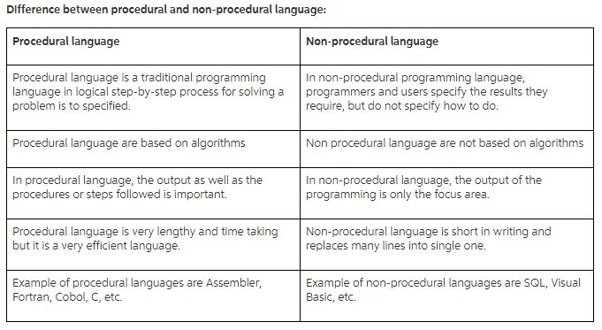
Procedural vs non Procedural Language

Slide 35
Procedure vs Function
A function returns a value and a procedure just executes commands.
In most programming languages, even functions can have a set of commands. Hence the difference is only in the returning a value part.
Example in c:
// function
int square( int n ) {
return n * n;
}
// procedure
void display( int n ) {
printf( "The value is %d", n );
}

Slide 36
SQL
Why SQL is required
SQL is required:
To create new databases, tables and views
To insert records in a database
To update records in a database
To delete records from a database
To retrieve data from a database

Slide 37
SQL
What SQL does
With SQL, we can query our database in a numbers of ways, using English-like statements.
With SQL, user can access data from relational database management system.
It allows user to describe the data.
It allows user to define the data in database and manipulate it when needed.
It allows user to create and drop database and table.
It allows user to create view, stored procedure, function in a database.
It allows user to set permission on tables, procedure and view.

Slide 38
types of SQL commands
SQL commands are instructions. It is used to communicate with the database. It is also used to perform specific tasks, functions, and queries of data.
SQL can perform various tasks like create a table, add data to tables, drop the table, modify the table, set permission for users.
There are five types of SQL commands: DDL, DML, DCL, TCL, and DQL.
Data Definition Language (DDL): DDL changes the structure of the table like creating a table, deleting a table, altering a table, etc.
Data Manipulation Language (DML): DML commands are used to modify the database. It is responsible for all form of changes in the database.

Slide 39
types of SQL commands
Data Control Language (DCL): DCL commands are used to grant and take back authority from any database user.
Transaction Control Language (TCL): TCL commands can only use with DML commands like INSERT, DELETE and UPDATE only.
Data Query Language (DQL): DQL is used to fetch the data from the database.

Slide 40
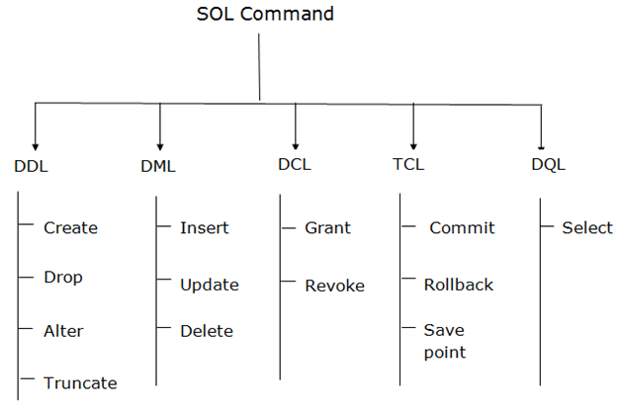
types of SQL commands

Slide 41
SQL
SQL DATABASE SQL CREATE, DROP and RENAME DATABASE
SQL TABLE SQL CREATE, DROP, DELETE, RENAME, TRUNCATE and COPY TABLE
SQL SELECT SQL SELECT statement with UNIQUE, DISTINCT, AS and IN keywords and first(), last(), top(), sum(), random() and count() functions.
SQL INSERT SQL INSERT INTO, INSERT SELECT and INSERT multiple rows.
SQL UPDATE SQL UPDATE statement, update with JOIN and update DATE.
SQL DELETE SQL DELETE TABLE, DELETE One Row, DELETE all rows, DELETE VIEW, DELETE database, DELETE duplicate rows and DELETE with INNER JOIN.

Slide 42
SQL
SQL JOIN Tutorial Our SQL join tutorial provides full detail of INNER JOIN, OUTER JOIN, LEFT OUTER JOIN, RIGHT OUTER JOIN and SELF JOIN.
SQL Keys SQL keys are primary key, composite key, foreign key, alternate key and unique key. In SQL keys tutorial, we will provide description and examples of each key.

Slide 43
BASIC QUERIES
Once logged in, you can try some simple queries.
For example:
MariaDB [(none)]> SELECT VERSION(), CURRENT_DATE;
+-----------+--------------+
| VERSION() | CURRENT_DATE |
+-----------+--------------+
| 3.23.49 | 2002-05-26 |
+-----------+--------------+
1 row in set (0.00 sec)
Note that most MySQL commands end with a semicolon (;)
MySQL returns the total number of rows found, and the total time to execute the query.

Slide 44
BASIC QUERIES
Keywords may be entered in any lettercase.
The following queries are equivalent:
MariaDB [(none)]> SELECT VERSION(), CURRENT_DATE;
MariaDB [(none)]> select version(), current_date;
MariaDB [(none)]> SeLeCt vErSiOn(), current_DATE;

Slide 45
BASIC QUERIES
Here's another query. It demonstrates that you can use mysql as a simple calculator:
MariaDB [(none)]> SELECT SIN(PI()/4), (4+1)*5;
+-------------+---------+
| SIN(PI()/4) | (4+1)*5 |
+-------------+---------+
| 0.707107 | 25 |
+-------------+---------+

Slide 46
BASIC QUERIES
You can also enter multiple statements on a single line. Just end each one with a semicolon:
MariaDB [(none)]> SELECT VERSION(); SELECT NOW();
+--------------+
| VERSION() |
+--------------+
| 3.22.20a-log |
+--------------+
+---------------------+
| NOW() |
+---------------------+
| 2004 00:15:33 |
+---------------------+

Slide 47
MULTI-LINE COMMANDS
mysql determines where your statement ends by looking for the terminating semicolon, not by looking for the end of the input line.
Here's a simple multiple-line statement:
MariaDB [(none)]> SELECT
-> USER()
-> ,
-> CURRENT_DATE;
+--------------------+--------------+
| USER() | CURRENT_DATE |
+--------------------+--------------+
| joesmith@localhost | 1999-03-18 |
+--------------------+--------------+

Slide 48
CANCELING A COMMAND
If you decide you don't want to execute a command that you are in the process of entering, cancel it by typing \c
MariaDB [(none)]> SELECT
-> USER()
-> \c
mysql>

Slide 49
USING A DATABASE
To get started on your own database, first check which databases currently exist.
Use the SHOW statement to find out which databases currently exist on the server:
MariaDB [(none)]> show databases;
+----------+
| Database |
+----------+
| mysql |
| test |
+----------+
2 rows in set (0.01 sec)

Slide 50
USING A DATABASE
To create a new database, issue the “create database” command:
MariaDB [(none)]> create database webdb;
To the select a database, issue the “use” command:
MariaDB [(none)]> use webdb;

Slide 51
CREATING A TABLE
Let’s create a table for storing pets.
Table: pets
name: VARCHAR(20)
owner: VARCHAR(20)
species: VARCHAR(20)
gender: CHAR(1)
birth: DATE
date: DATE

Slide 52
CREATING A TABLE
To create a table, use the CREATE TABLE command:
MariaDB [webdb]> CREATE TABLE pet (
-> name VARCHAR(20),
-> owner VARCHAR(20),
-> species VARCHAR(20),
-> gender CHAR(1),
-> birth DATE, death DATE);
Query OK, 0 rows affected (0.04 sec)

Slide 53
SHOWING TABLES
To verify that the table has been created:
MariaDB [webdb]> show tables;
+------------------+
| Tables_in_test |
+------------------+
| pet |
+------------------+
1 row in set (0.01 sec)

Slide 54
DESCRIBING TABLES
To view a table structure, use the DESCRIBE command:
MariaDB [webdb]> describe pet;
+---------+-------------+------+-----+---------+-------+
| Field | Type | Null | Key | Default | Extra |
+---------+-------------+------+-----+---------+-------+
| name | varchar(20) | YES | | NULL | |
| owner | varchar(20) | YES | | NULL | |
| species | varchar(20) | YES | | NULL | |
| sex | char(1) | YES | | NULL | |
| birth | date | YES | | NULL | |
| death | date | YES | | NULL | |
+---------+-------------+------+-----+---------+-------+
6 rows in set (0.02 sec)

Slide 55
DELETING A TABLE/Database
To delete an entire table, use the DROP TABLE command:
MariaDB [webdb]> drop table pet;
Query OK, 0 rows affected (0.02 sec)
To delete an entire database, use the DROP DATABASE command:
MariaDB [webdb]> drop database webdb;
Query OK, 0 rows affected (0.02 sec)

